Slide 1
"Digital Media Primer" Yue-Ling Wong,
Copyright (c)2016 by Pearson Education, Inc. All rights reserved.
© 2016 Pearson Education, Inc., Hoboken, NJ. All rights reserved.

Slide 2
Chapter 1
Background
Part 3
How bits represent information
© 2016 Pearson Education, Inc., Hoboken, NJ. All rights reserved.

Slide 3
In this lecture, you will find answers to these questions
How do bits represent digital media information?
© 2016 Pearson Education, Inc., Hoboken, NJ. All rights reserved.

Slide 4
REVIEW: BITS
© 2016 Pearson Education, Inc., Hoboken, NJ. All rights reserved.

Slide 5
Review
In computer systems, data is stored and represented in binary digits, called bits.
We use eyes in the eye signals as an analogy.
© 2016 Pearson Education, Inc., Hoboken, NJ. All rights reserved.

Slide 6
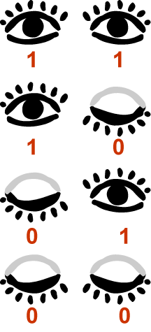
Two eyes, Four Combinations of Open and Closed
© 2016 Pearson Education, Inc., Hoboken, NJ. All rights reserved.

Slide 7
Encoding and Decoding Your Eye Signals
To communicate with your friends with your eye signals, you will need to assign meanings (or messages) to the different combinations of open and closed eyes--encoding the message.
In order to use your eye signals to communicate with your friends, they will need to know how to interpret your eye signals--decoding your eye signals.
© 2016 Pearson Education, Inc., Hoboken, NJ. All rights reserved.

Slide 8
Two eyes, Four Combinations of Open and Closed
You may assign a different meaning to each combination of open and close eyes.
© 2016 Pearson Education, Inc., Hoboken, NJ. All rights reserved.

Slide 9
Two eyes, Four Combinations of Open and Closed
You may assign "red" to this
You may assign "black" to this
You may assign "blue" to this
You may assign "yellow" to this
© 2016 Pearson Education, Inc., Hoboken, NJ. All rights reserved.

Slide 10
Bits
In computer systems, data is stored and represented in binary digits, called bits.
A bit has two possible values, 0 or 1.
© 2016 Pearson Education, Inc., Hoboken, NJ. All rights reserved.

Slide 11
Recall Our Eye Signals
Say, we give the open eye a 1 and the closed eye a 0.
We can think of each eye is a bit.
We can think of our 2-eye signal system is a 2-bit system.
As you see, 2-bit system can encode 4 messages (or choices of things.)
© 2016 Pearson Education, Inc., Hoboken, NJ. All rights reserved.

Slide 12
Number of possible values = 2^{(number of bits)}
More bits can encode more information.
More bits require more computer storage.
© 2016 Pearson Education, Inc., Hoboken, NJ. All rights reserved.

Slide 13
DONE REVIEW: BITS
© 2016 Pearson Education, Inc., Hoboken, NJ. All rights reserved.

Slide 14
Using bits to represent numeric values
Base-10 and Base-2 Conversion
© 2016 Pearson Education, Inc., Hoboken, NJ. All rights reserved.

Slide 15
Decimal Notation
Base-10
Commonly used in our daily life
Use combinations of 10 different numerals to construct any values
The 10 different numerals are:
  0, 1, 2, 3, 4, 5, 6, 7, 8, 9
© 2016 Pearson Education, Inc., Hoboken, NJ. All rights reserved.

Slide 16
Base-10 Example
The decimal number 5872 is interpreted as follows.
5
0
0
0
8
0
0
7
0
+
2
5
8
7
2
© 2016 Pearson Education, Inc., Hoboken, NJ. All rights reserved.

Slide 17
Base-10 Example
In other words,
5
8
7
2
=
5
x 10³ +
8
x 10² +
7
x 10¹ +
2
x 10⁰
=
5
x 1000 +
8
x 100 +
7
x 10 +
2
x 1
=
5
000 +
8
7
00 +
0 +
2
=
5
8
7
2
© 2016 Pearson Education, Inc., Hoboken, NJ. All rights reserved.

Slide 18
Binary Notation
Base-2
Used in machine language (language that computers understand)
Use combinations of 2 different numerals to construct any values
The 2different numerals are:
  0, 1
© 2016 Pearson Education, Inc., Hoboken, NJ. All rights reserved.

Slide 19
Base-2 Example
The binary notation 1011 is interpreted as follows.
1
0
1
1
=
1
x 2³ +
0
x 2² +
1
x 2¹ +
1
x 2⁰
=
1
x 8 +
0
x 4 +
1
x 2 +
1
x 1
=
8
+
0
2
+
+
1
=
11 (eleven, in decimal notation)
© 2016 Pearson Education, Inc., Hoboken, NJ. All rights reserved.

Slide 20
Base-2 to Base-10
The previous slide shows the base-2 to base-10 conversion method.
1101₂ (one one zero one) represents 11₁₀ (eleven).
The subscript indicates the base.
© 2016 Pearson Education, Inc., Hoboken, NJ. All rights reserved.

Slide 21
Base-10 to Base-2
To convert base-10 to base-2 notation:
repeatedly divide the decimal number by 2 until it becomes 0, noting the remainder of each division.
The reverse order of the sequence of the remainders is the binary representation of the decimal number.
© 2016 Pearson Education, Inc., Hoboken, NJ. All rights reserved.

Slide 22
Base-10 to Base-2 Example
To convert 19₁₀ to binary notation:
19 / 2 = 9 remainder 1
9 / 2 = 4 remainder 1
4 / 2 = 2 remainder 0
2 / 2 = 1 remainder 0
1 / 2 = 0 remainder 1
© 2016 Pearson Education, Inc., Hoboken, NJ. All rights reserved.

Slide 23
Base-10 to Base-2 Example
To convert 19₁₀ to binary notation:
19 / 2 = 9 remainder 1
9 / 2 = 4 remainder 1
4 / 2 = 2 remainder 0
2 / 2 = 1 remainder 0
1 / 2 = 0 remainder 1
10011₂
© 2016 Pearson Education, Inc., Hoboken, NJ. All rights reserved.

Slide 24
Examples
Decimal | Binary
0 | 0
1 | 1
2 | 10
3 | 11
4 | 100
5 | 101
6 | 110
7 | 111
© 2016 Pearson Education, Inc., Hoboken, NJ. All rights reserved.

Slide 25
Using bits to represent text
By assigning unique numbers to each text character
© 2016 Pearson Education, Inc., Hoboken, NJ. All rights reserved.

Slide 26
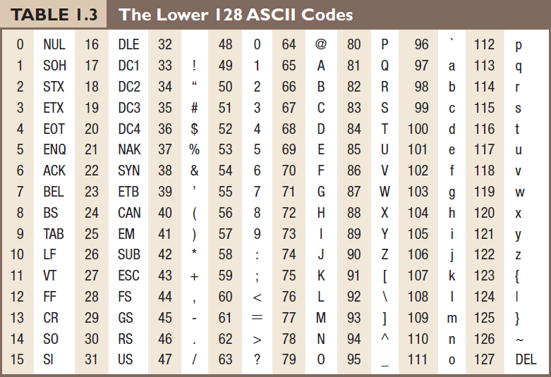
For example, the character A is represented by 65.
© 2016 Pearson Education, Inc., Hoboken, NJ. All rights reserved.

Slide 27
ASCII
stands for American Standard Code for Information Interchange
an encoding standard for text characters, including the 26-letter English alphabets and symbols in computer programs.
© 2016 Pearson Education, Inc., Hoboken, NJ. All rights reserved.

Slide 28
ASCII
For ASCII character set, each character uses 8 bits.
With 8 bits, you can encode 2⁸ = 256 different characters.
© 2016 Pearson Education, Inc., Hoboken, NJ. All rights reserved.

Slide 29
Unicode
another standard for encoding text character
can represent a large repertoire of multilingual characters
use more than 8 bits to encode a text character because multilingual character sets are larger than the ASCII set
© 2016 Pearson Education, Inc., Hoboken, NJ. All rights reserved.

Slide 30
Using bits to represent images
© 2016 Pearson Education, Inc., Hoboken, NJ. All rights reserved.

Slide 31
Using bits to represent images
Bitmap images, such as digital photos
  color value of each pixel encoded into bits
Vector graphics, such as graphics created in Flash
  coordinates of anchor points encoded into bits
  tangent of each anchor points encoded into bits
Bitmap images, vector graphics, and pixels will be explained in the digital images chapters
© 2016 Pearson Education, Inc., Hoboken, NJ. All rights reserved.

Slide 32
Using bits to represent sound
© 2016 Pearson Education, Inc., Hoboken, NJ. All rights reserved.

Slide 33
Using bits to represent sound
sampled audio
  amplitude for each sample encoded into bits
  For CD quality audio, it has 44,100 samples per second of the audio
MIDI music
  each musical instrument has an ID which can be encoded into bits
  each musical note has an ID which can be encoded into bits
Sampled audio and MIDI will be explained in the audio chapters
© 2016 Pearson Education, Inc., Hoboken, NJ. All rights reserved.

Slide 34
Using bits to represent program instructions
By using a sequence of bits to represent an operation
© 2016 Pearson Education, Inc., Hoboken, NJ. All rights reserved.

Slide 35
Using bits to represent program instructions
For example, an arithmetic addition may be represented by a sequence of bits:
001100
© 2016 Pearson Education, Inc., Hoboken, NJ. All rights reserved.

Slide 36
File Sizes
In a text document that uses ASCII code to represent text characters, each byte stores an ASCII code that corresponds to a character.
The more characters in a text document, the more bytes are required to store the file.
Digital media files (image, sound, and especially video files) can be very large.
© 2016 Pearson Education, Inc., Hoboken, NJ. All rights reserved.

Slide 37
Disadvantages of Large File Size
take longer to copy the file from one computer to another
take longer to send the file over the Internet
take longer to process (such as during opening and saving) the file
© 2016 Pearson Education, Inc., Hoboken, NJ. All rights reserved.

Slide 38
Strategies to Reduce Digital Media File Size
Reduce the sampling rate
Reduce the bit depth
Apply file compression
© 2016 Pearson Education, Inc., Hoboken, NJ. All rights reserved.

Slide 39
Reduce Sampling Rate
Recall the weighing puppy scenario
If you weigh the puppy more frequently, it will take more paper.
For digital media files, higher sampling rate means more data to store.
In other words, lower sample rate will produce less data, i.e. smaller file size.
© 2016 Pearson Education, Inc., Hoboken, NJ. All rights reserved.

Slide 40
Reduce Bit Depth
Bit depth refers to the number of allowable levels you can map the data
For digital media files, lower bit depth means less data to store.
© 2016 Pearson Education, Inc., Hoboken, NJ. All rights reserved.

Slide 41
Compression
File compression means techniques to reduce file size
Two categories in terms of whether the data get lost during the compression:
  lossy compression
  lossless compression
© 2016 Pearson Education, Inc., Hoboken, NJ. All rights reserved.

Slide 42
Lossy Compression
Some data will be lost and cannot be recovered
Examples:
  JPEG compression for images
  MP3 for audio
  most compressors for videos
© 2016 Pearson Education, Inc., Hoboken, NJ. All rights reserved.

Slide 43
Lossy Compression
Avoid using lossy compression (if possible) when you want to keep the file for further editing.
Generally, you can do so with images and audio.
Video files are generally so large that it is inevitable to save them with lossy compression.
© 2016 Pearson Education, Inc., Hoboken, NJ. All rights reserved.

Slide 44
Trade-offs of Reducing File Size
Data will be lost or altered when you apply these strategies:
reduce sampling rate
reduce bit depth
apply lossy compression
When data is lost or altered, you sacrifice the exactness of the media original information. This affects the quality of the media.
© 2016 Pearson Education, Inc., Hoboken, NJ. All rights reserved.

Slide 45
Weighing the Trade-offs
Depend on projects and intended use of the files
Weigh the file size (storage requirement and speed of transfer and processing of the file) against the quality of the digital media files
Losing data vs. "perceivable" quality
  Sometimes it may be acceptable if losing data does not cause "perceivable" deterioration in quality
© 2016 Pearson Education, Inc., Hoboken, NJ. All rights reserved.

Slide 46
Example: MP3
MP3 audio uses a lossy compression.
It reduces the file size by selectively removing and altering the audio data (such as certain ranges of audio frequencies) that are not very perceivable by human.
© 2016 Pearson Education, Inc., Hoboken, NJ. All rights reserved.

Slide 47
Review Questions
Note to instructor:
Depending on your preference, you may want to go over the review questions at the end of this lecture as an instant review or at the beginning of next lecture to refresh students' memory of this lecture.
© 2016 Pearson Education, Inc., Hoboken, NJ. All rights reserved.

Slide 48
Review Question
Our everyday decimal numbering system is base-_____. Computers use base-_____ , which is also known as the _____ numbering system.
© 2016 Pearson Education, Inc., Hoboken, NJ. All rights reserved.
Notes:
10, 2, binary

Slide 49
Review Question
This is a quote from a T-shirt:
"There are only 10 types of people in the world:
Those who understand binary and those who don't."
How many types does this quote actually mean?
(Hint: It is talking in binary!)
© 2016 Pearson Education, Inc., Hoboken, NJ. All rights reserved.
Notes:
two because 10₂ = 2₁₀

Slide 50
Review Question
(i) Name three general strategies to reduce the size of a digital media file.
(ii) Which of these strategies does not necessarily sacrifice the quality of the media file?
© 2016 Pearson Education, Inc., Hoboken, NJ. All rights reserved.
Notes:
(i) reduce sampling rate, reduce bit-depth, apply compression
(ii) lossless compression

Slide 51
Review Question
In general, if you want to keep a digital media file for further editing, you should _____.
A. avoid applying lossy compression
B. avoid applying lossless compression
© 2016 Pearson Education, Inc., Hoboken, NJ. All rights reserved.
Notes:
A

